Slide 1

Effective Learning
Goldrick, M (2008)
Unit 3: Academic Writing and Referencing

Slide 2
Essay writing
Written assignments are a tutors’ primary source of evidence that you as a student have not only understood your coursework but have created some of your own ideas about what you have learned. Therefore when writing any academic assignment keep in mind that you will be expected to;
Describe the area of study or phenomena
Critically evaluate previous thinking around the subject
Construct an argument about your views about the subject

Slide 3
Getting started..
Your first assignments in NCI will most likely be short essays between (1500-2000 words). Rather than be asked to write a descriptive essay you will be asked to write a critical essay which means when planning your essay keep in mind;
The Question: What is the essay asking you to do? Get to know the differences between describe, discuss and evaluate.
The Structure: Each section of your assignment should be distinguishable from the rest. (I.e. the Introduction of the topic, main body of text, to discussion and finally the conclusion).
Sources of information: Try to back up each argument
you make with an appropriate reference!

Slide 4
Essay Planning
Below is an example of a sample question and how to approach it
*Essay Question: Evaluate your organisation’s marketing strategy*
Step 1: What is it asking you to do?
Step 2: Gather all initial needed material
(Relevant book chapters, websites, research articles etc..)
Step 3: Begin writing preliminary notes and start thinking about your essay’s layout, structure and audience (Marshall and Roland, 1993)

Slide 5
Creating notes and “brainstorming”
It’s good practice to start writing as soon as possible no matter what type of assignment you are tackling. To get started try developing ideas about the topic under investigation and try to link up your thinking with published works (see Nolan, 2004, p18)
Ethical operation code
Branding history
Cola Company..
Product diversity
69% of Cuban Market

Slide 6
Essay Structure
The structure of an essay is pretty universal in so far as it should contain 3 core elements; Introduction, main body and conclusion;
1. Introduction
This section will introduce the topic, highlight the question and how you intend to address it.
2. Body of your essay
Each paragraph should be linked to a theme which utilises both your own views and published works in a critical manner.
3. Conclusion
This should summarise your work, analysis and recommendations

Slide 7
Example Introductions
Question: “Discuss the consequences of ignoring the World economy in relation to Irish lending practices.”
Direct Approach: In this essay the consequences of ignoring the world economy will be discussed in relation to Irish lending practices. In order to do this, the essay will firstly outline the current economic climate and how a swift recession has affected global economics. Having done this, the essay will then illustrate how the current state of global economics has affected Irish money lending practices..
Indirect Approach: The topic of world economy is more and more becoming a buzz word in not only political and economic arenas, but in living rooms, bars and offices throughout the world..
Try to keep your writing clear and simple and make use of
The third Party writing style as often as possible..

Slide 8
Linking paragraphs and theme building
In your main body of text, each paragraph should be linked to a specific theme to do with the essay. For instance; when analysing a theory or model, aim to link each paragraph to specific features or attributes;
Morgan’s (1998) model of Financial boons has many strengths, that testify to its popularity. Perhaps most noteworthy of these strengths, is linked to the model’s self-inflating returns, which are perceived by many to be a form of stand-alone economics (Edgar, 2000, Ryan, 2001). Nevertheless, as Jefferson (2006) highlights, Morgan’s model of financial boons maybe classified best as not stand-alone economics, but voodoo economics.

Slide 9
Critical Thinking
As a third level student you are faced with copious amounts of information to take on board on a daily, never mind weekly basis.
It is important however, not to passively accept any information from textbooks, articles or online sources:
(a good example of this is wikipedia)
Always ask yourself,
Has the author an agenda or bias (e.g. propaganda)
Is this text a reflection of present thinking?
Is this research author an expert on the subject?
Is the author trustworthy?
Is there any other source that might contradict
the author’s beliefs?

Slide 10



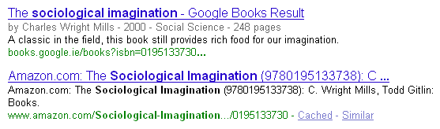


Slide 11

In NCI you will be using what is known as the Harvard Style Reference system. Citing refers to the use of publicised works in your main body of writing, whereas referencing and bibliography are located at the end of your work (giving an alphabetized list of sources. Some questions you might have about this are;
Why do we reference?
How do we reference?

Slide 12
Short and Long Quoting in the text
Short quotes refer to the usage of quotes which are no more than a sentence long. For example;
Stark et al (2002: p11) describes the purpose of essays as “an exercise in written revision and conceptual exploration”.
Long Quotes refer to quotes which are longer than one sentence and are set apart from the text by one line spacing and indenting.

Slide 13

Essay title: What is Learning Support?
The role of learning support is outlined by Goldrick (2008) who endorses the contemporary view that students who self-advocate tend to advance the quality of their learning more, compared to those who do not self advocate, (Stark et al, 2002). In principle the history of the role itself is relatively new;
“Throughout Irish education there are certain buzz words
such as equality and inclusion which are becoming a
prelude to social change. This change surrounds the
conception of education itself and how we all perceive
learning.”
(Goldrick, 2008, p16)

Slide 14
Example Bibliography
Goldrick, M (2008) The learning Support Kit. Dublin National College Of Ireland.
Stark, T, Ryan, R, Banner, B and Kent, K (2002) How we learn best. [internet] New York: Shieldman Development INC, available from:<http://www.Shieldinc.nyci.com
[accessed 8 September 2008]

Slide 15

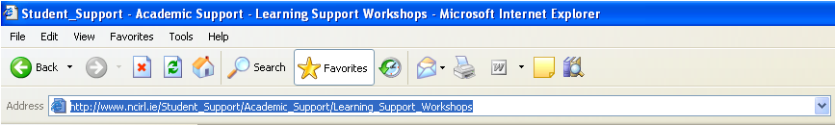
Think before you copy and paste! (always record the address)
Try to diversify your sources (i.e. don’t rely on one book or source for an assignment)
Use all the resources you have; the library, the internet, course books, newspapers, T.V broadcasts etc.
Get a copy of Nolan, A (2006) “HOW TO REFERENCE HARVARD STYLE” from the library.

Slide 16
Useful words and Phrases
Academic writing and essay writing in general has a clear structure that each of us has to follow. Therefore to help you navigate from one section to another here are some useful transitional words as laid out in the Learning Development Manual (2009) on page 19.

Slide 17

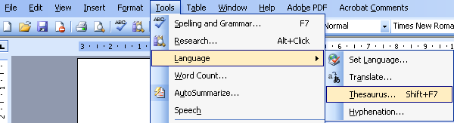
Using Word to help you
1. Spellign and grammar
Use the spelling and grammar tool often as it will point out any obvious spelling or sentence abnormalities (we all make mistakes).
2. Thesaurus
Use the thesaurus tool to help you with word choice options.

Slide 18
What Learning Support can do to help you with a written assignment
Proofing : By appointment only
( Generally for students who have difficulties with written English)
Question analysis
Essay Structure guidance
(When proofing your own work try reading the essay aloud
and watch out for words such as “There” and “Their” as
spell checker will not usually highlight any mix up.)

